Slide 1


Intelligent Academic Planner
Daria Cook, Krystal Elliott, Xiaoyu Zhou
February 24, 2017
Notes:
Bluemix data analytics for decision support

Slide 2



First… A Review:
What are we doing?
Using IBM Watson and BlueMix APIs to conduct textual analysis on questions asked by potential students and freshman students.
What is the need for this project?
Students are often unsure of which fields would coincide with their interests and talents.
What is our objective with this project?
Enable students to make better career decisions.

Slide 3
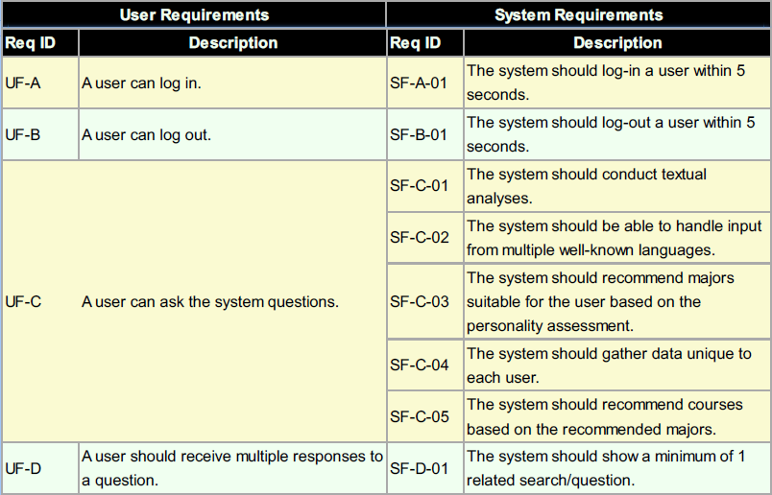

User & System Requirements

Slide 4
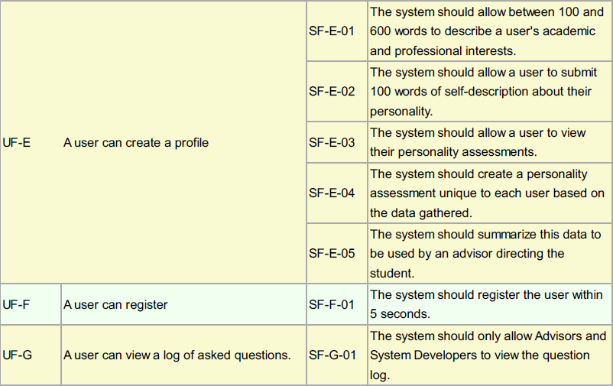
User & System Requirements

Slide 5
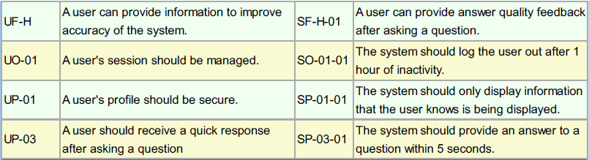
User & System Requirements

Slide 6
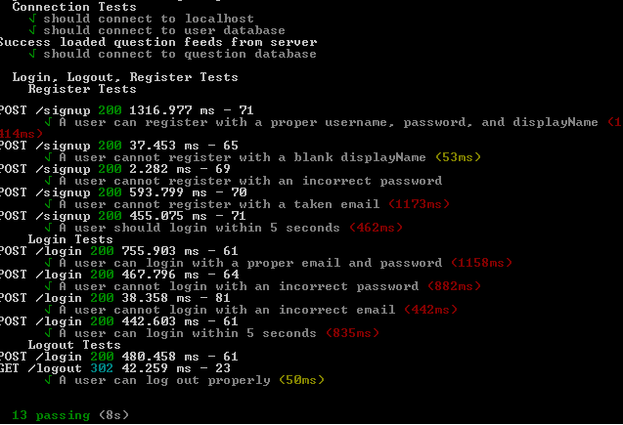

Slide 7


Summary of User & System Requirements
User Requirements: 9/11 Complete
System Requirements: 11/19 Complete

Slide 8
System Design Review
High level flow
Client
Server
Client
AI System
Question
Preprocessing
AI (Watson)
Learn
Feedback
Display

Slide 9
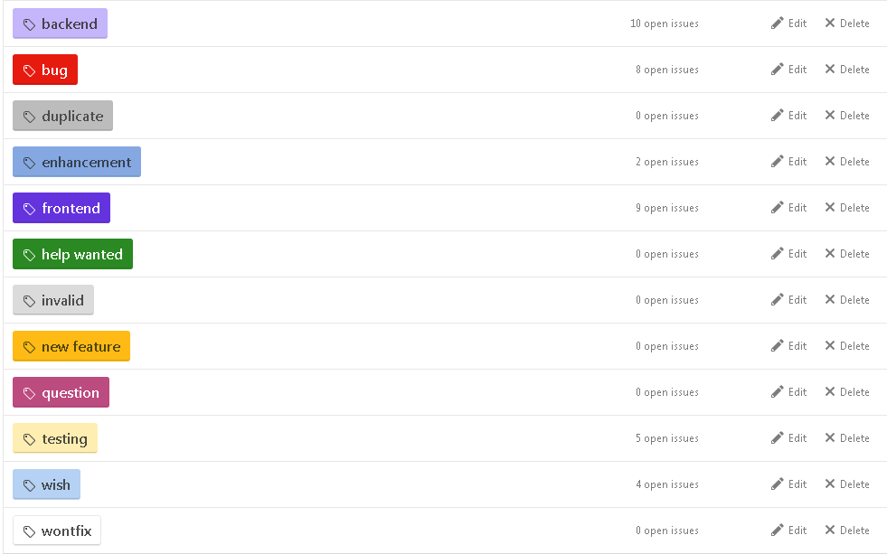
Project Management - GitHub

Slide 10
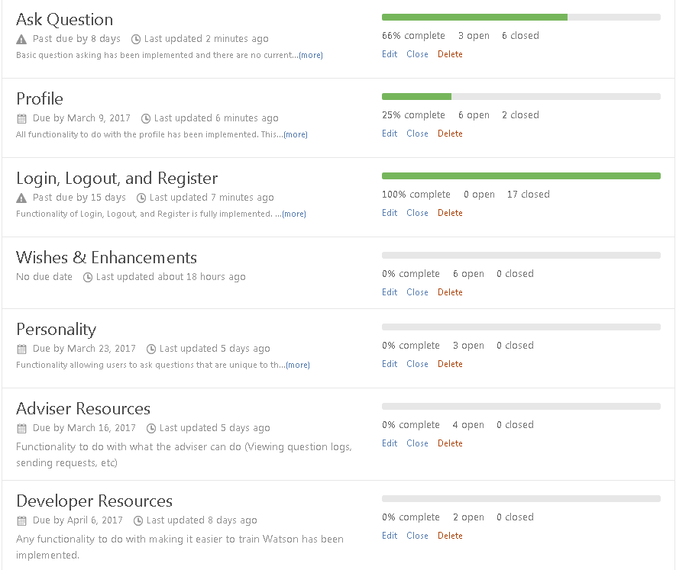

Slide 11
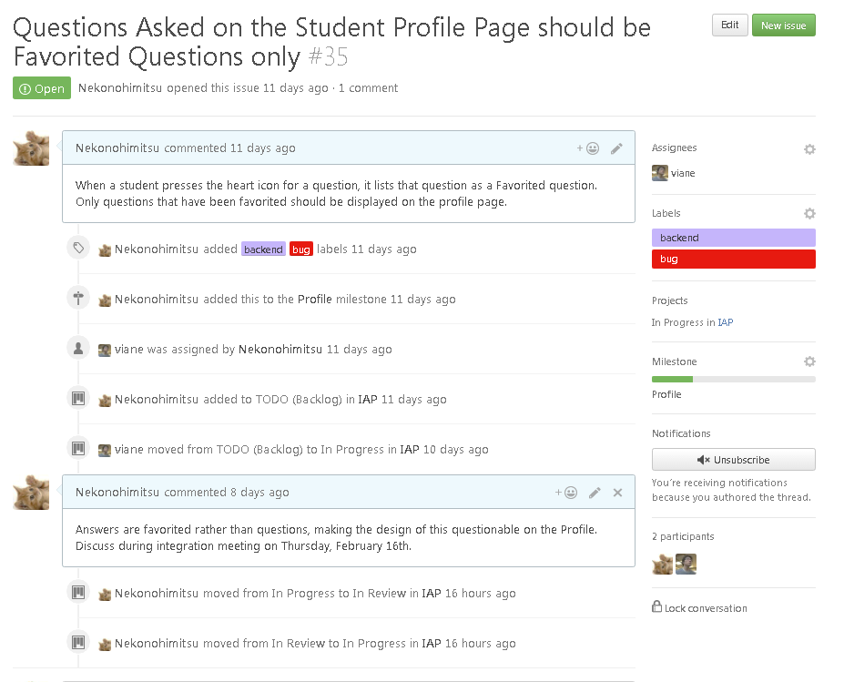

Slide 12
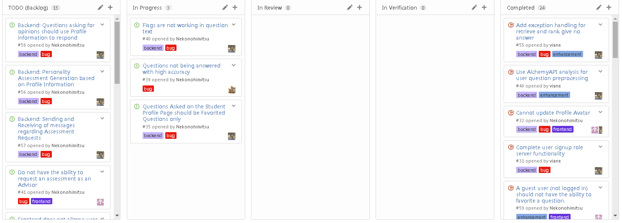

Slide 13
UI Design

Slide 14
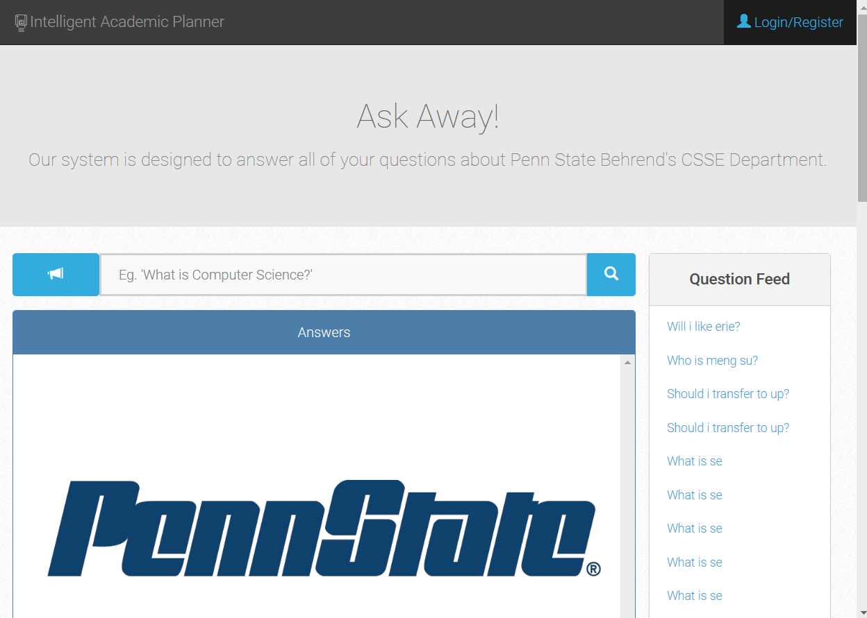

Slide 15
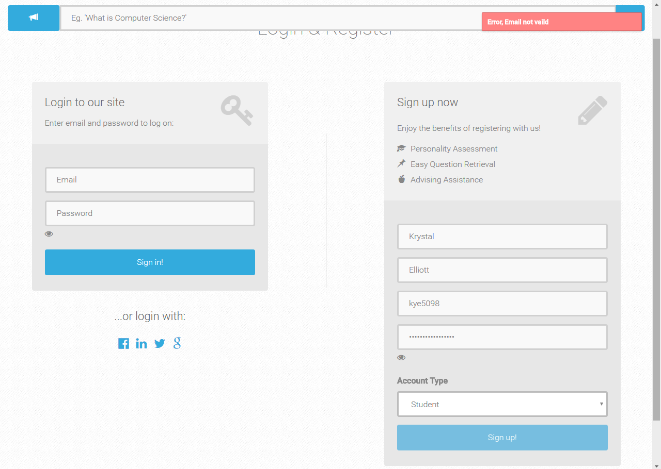

Slide 16
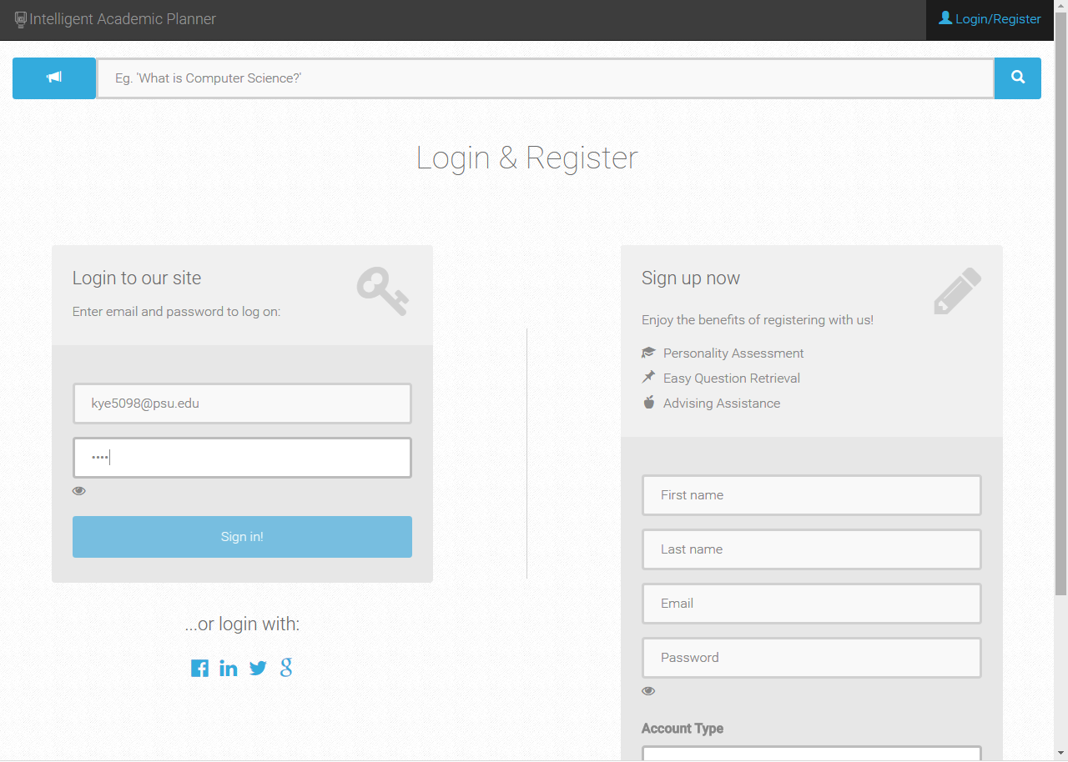

Slide 17
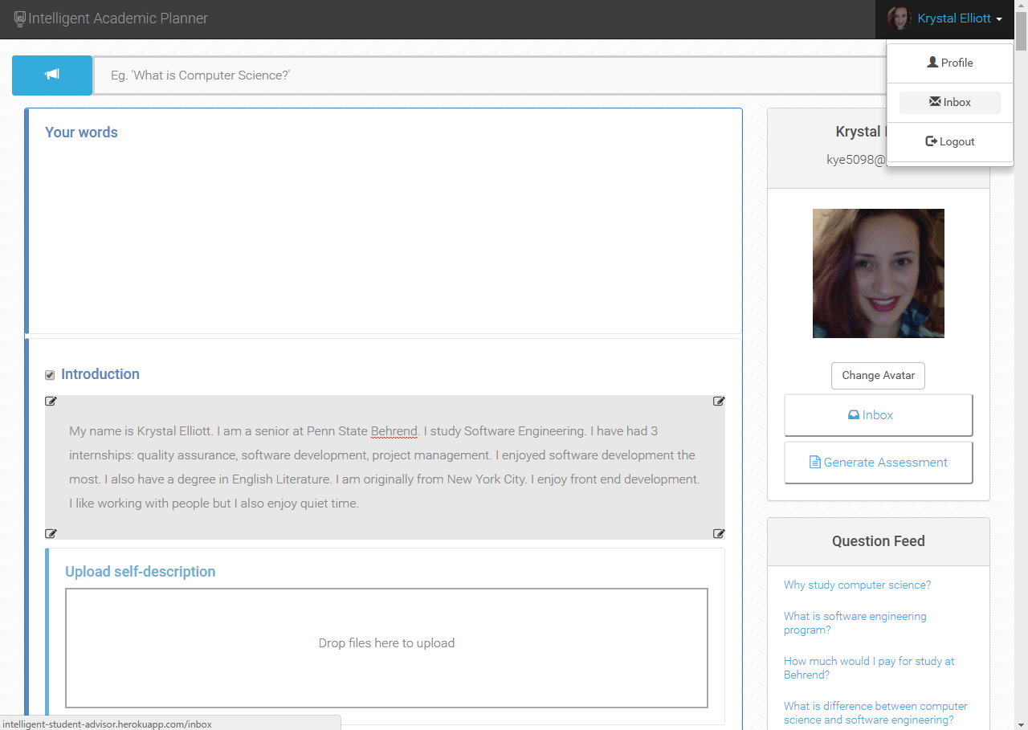
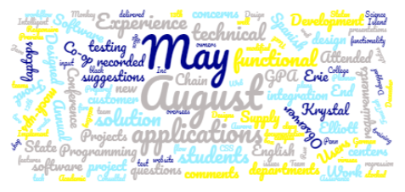
Notes:
Add’l Documents in profile page for assessment
Inbox that allows notifications periodically
Ask random questions to user to pull personality info

Slide 18
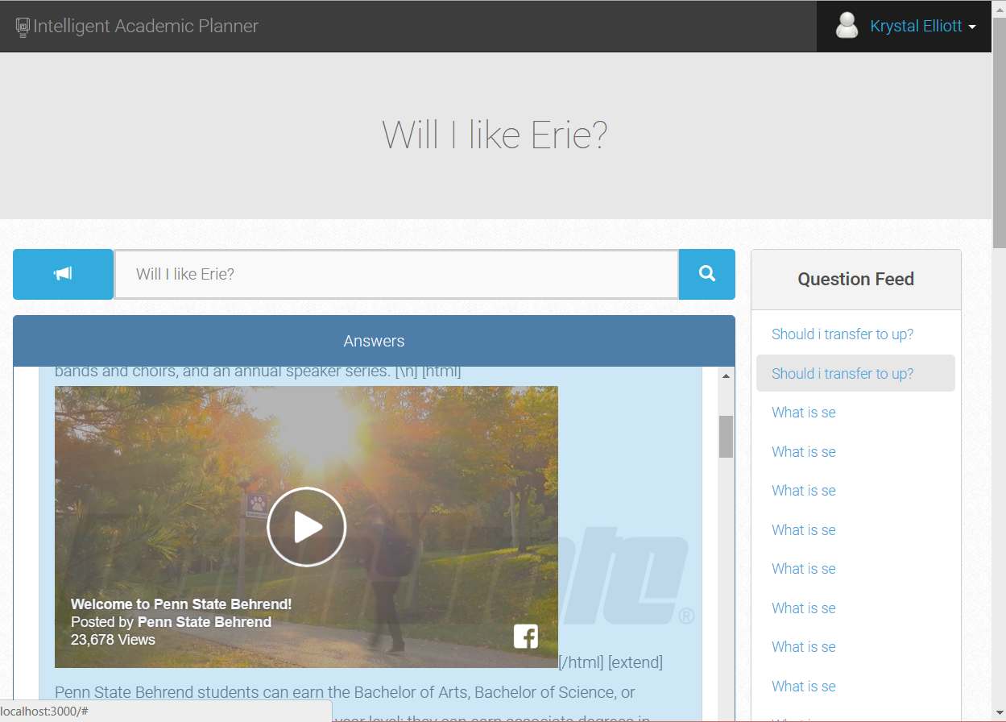

Slide 19
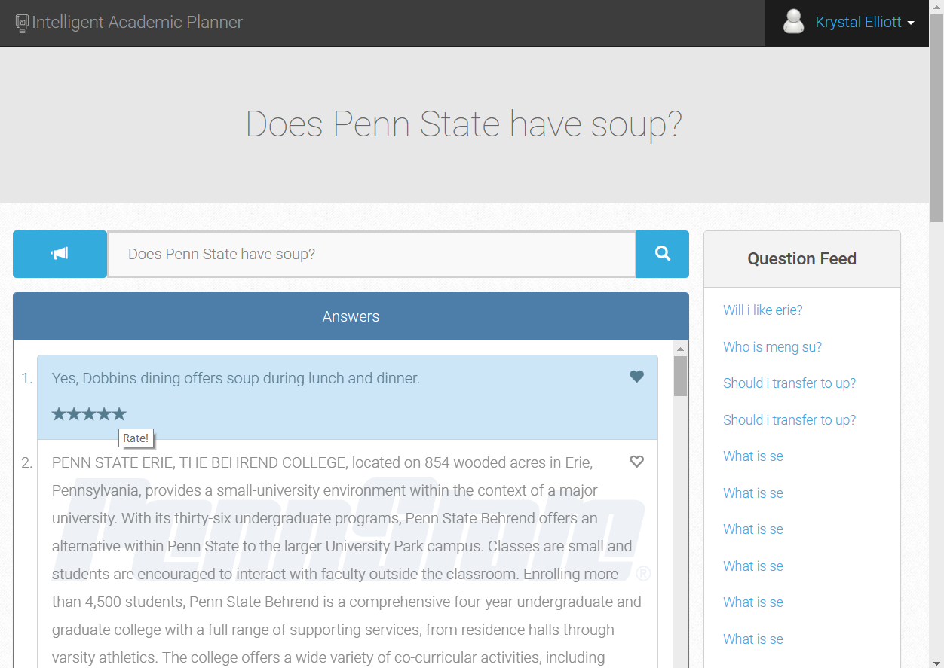

Slide 20


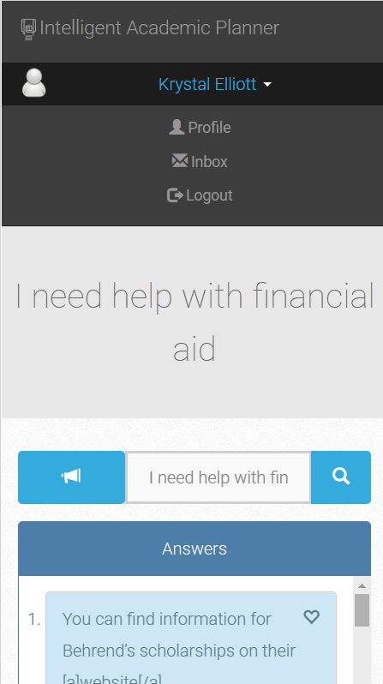

Slide 21
System Demonstration
Intelligent Academic Planner Website

Slide 22

QUESTIONS?

